Slide 1
Toby Simmerling
Development Manager

Slide 2
Experienced Coder 20 years experience. .Net 2.1 to Core. JQuery to Angular. | Practical and Pragmatic Aim for perfection but never let it get in the way of progress. Why say 100 words if 10 will do.
Achiever not Dreamer Proven history of turning ideas into realistic goals and delivering on expectations. | Composure Stop, look and listen. Ability to see the solution.
Leader Running teams of developers. Influencing practices. Changing perceptions of “done”. | Buffer/Barrier/Conduit Primary Goal Keep the Coders Coding. Ensuring developers can work to their highest standard.

Slide 3
First Job
Principle analyst in high court case
Over charged MD £35,000 (twice)
Perfect Job
Boredom
More to Achieve
Athlete
Marathons
Triathlons
Contractor
Good Working Practices
Bad Working Practices
Great Managers
Poor Managers
Family
Children Teach Compromise
Cancer Teaches Perseverance

Slide 4
Developer
First Job
Perfect Job
Athlete
Contractor
Family
Development Manager

Slide 5
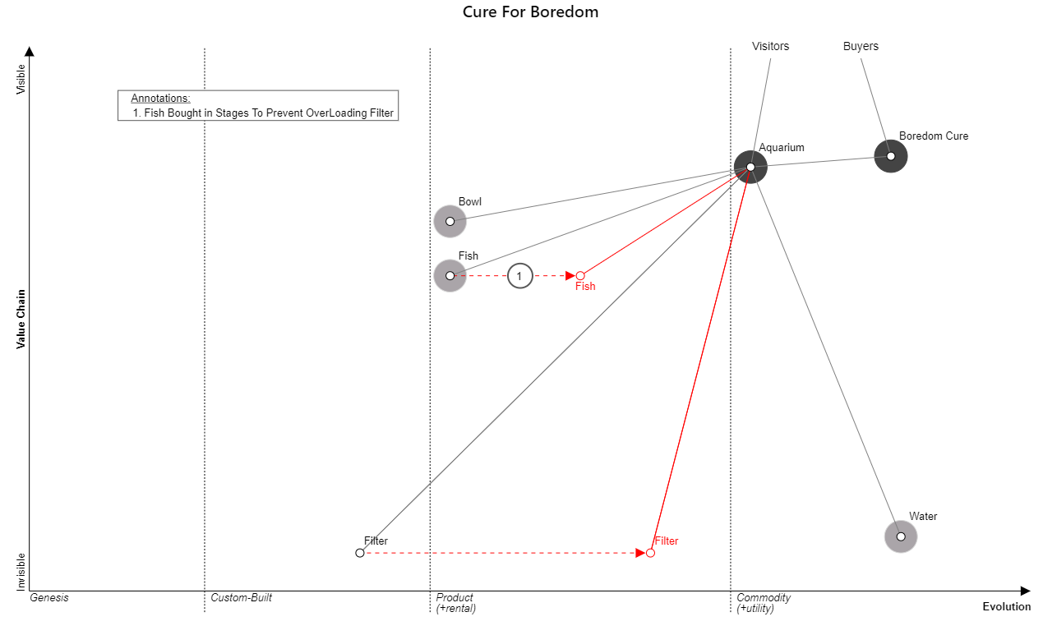
Example Wardley Map

Slide 6
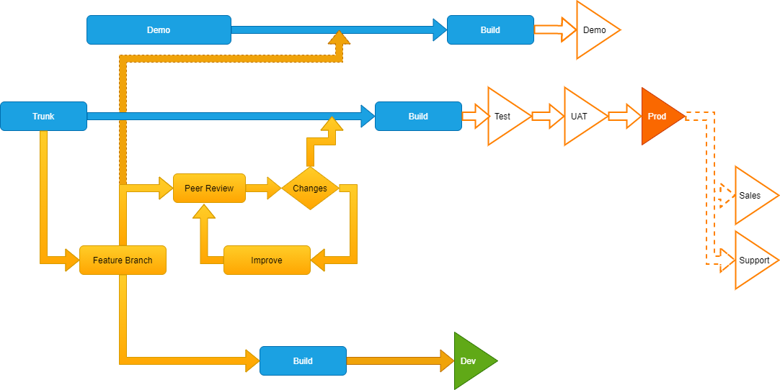
Optimal CI/CD Flow

Slide 7
Toby Simmerling
Development Manager
tobysimmerling@gmail.com
07968 040 980
01010100 01101111 01100010 01111001 00100000 01110011 01101001 01101101 01101101 01100101 01110010 01101100 01101001 01101110 01100111 00100000 00110000 00110111 00111001 00110110 00111000 00110000 00110100 00110000 00111001 00111000 00110000

